Slide 1
LEDs and NeoPixel

Slide 2
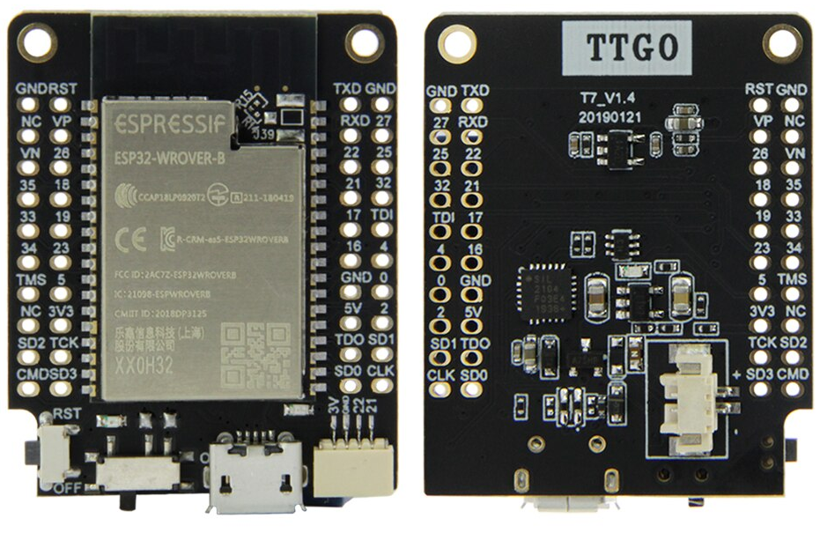
ESP32-WROVER-B Board
Datasheet: https://www.espressif.com/sites/default/files/documentation/esp32-wrover-b_datasheet_en.pdf

Slide 3
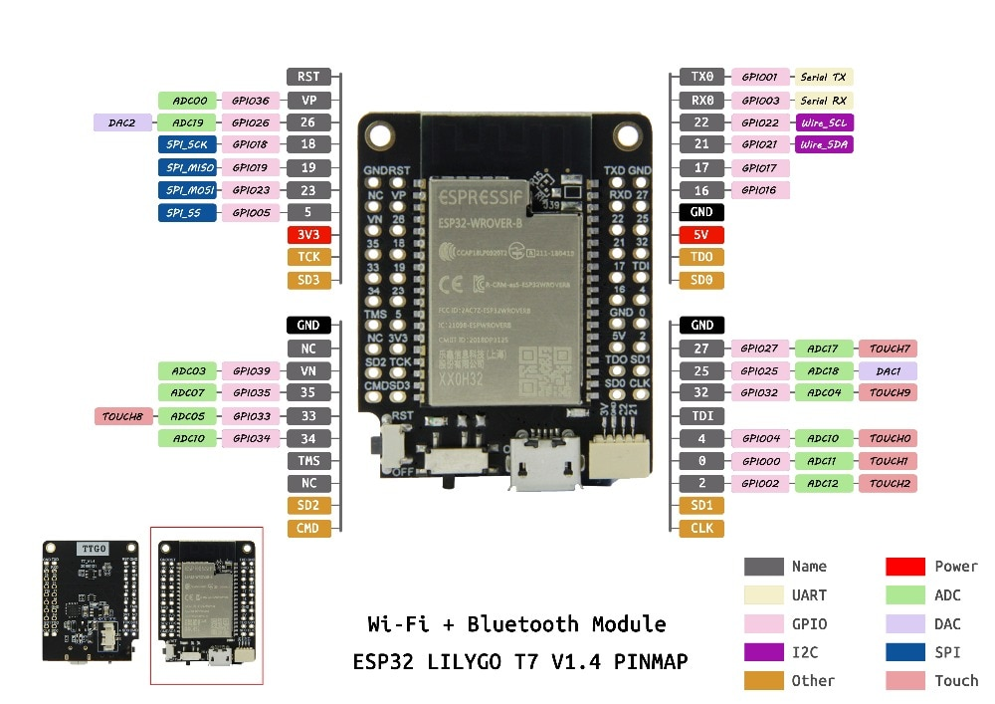
The pinout

Slide 4
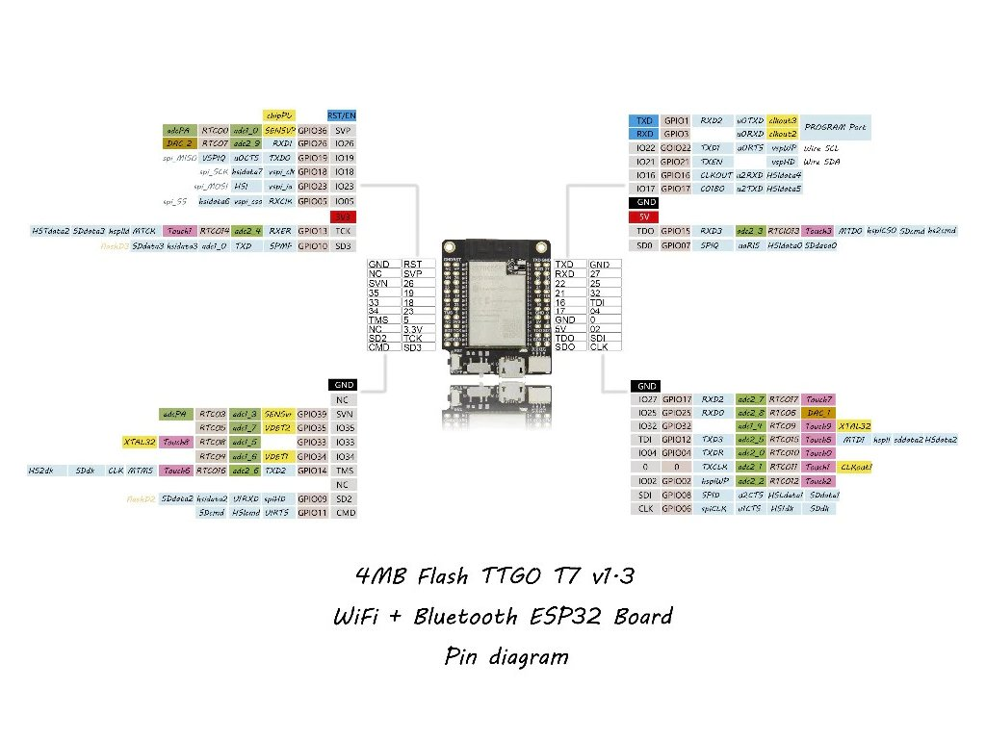
The WeMos D1 mini CPU card

Slide 5
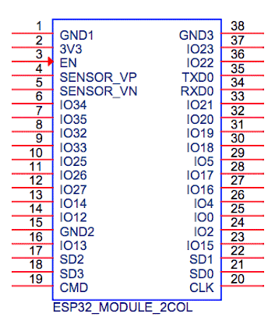

Slide 6
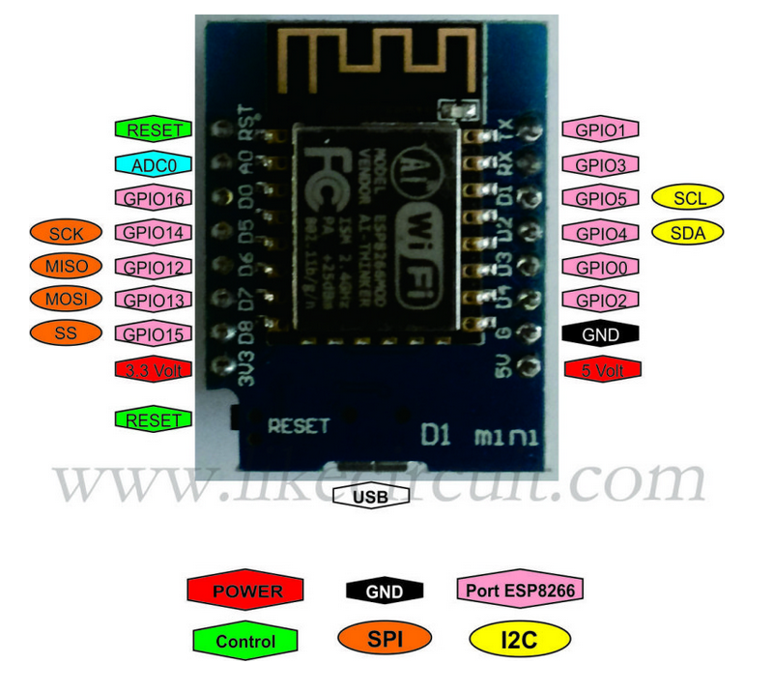
Meaning of pins
GPIO: General Purpose Input Output. Drives a single digital line which can be programmed input or output
SCL/SDA: The I2C bus: a 2 wire bus interfacing sensors or actuators to the CPU
SCL,MISO,MOSI,SS: SPI the Serial Peripheral Interface. Used fast communication with external device

Slide 7
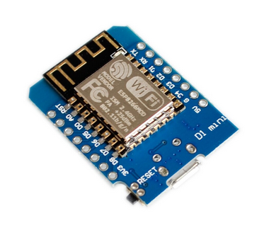

How to program the processor
Several development tools are available:
ESP_IDF: The official Espressif development tool. Include a gcc compiler for the ESP8266 and the ESP32
The Arduino IDE Needs extensions for these processors and the different CPU boards
MicroPython
See: https://docs.espressif.com/projects/esp-idf/en/latest/
Micro USB connector

Slide 8
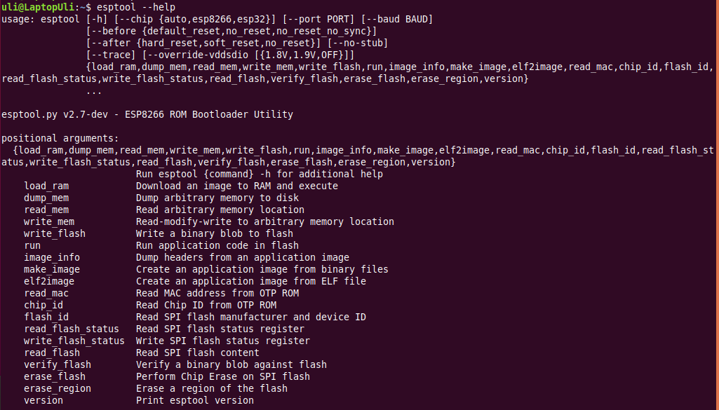
Flashing the code

Slide 9
esptool
esptool is called from the Makefiles in ESP-IDF
esptool is used when we upload code from the Arduino IDE to the processor flash
esptool is used when the Micropython IDEs uPyCraft or Thonny is used to installs Micropython onto the processor flash
In the above cases the use of esptool is hidden to us. We can however also execute esptool directly.

Slide 10
How to write a Micropython program?
First we need a Micropython interpreter!
You find the sources here: https://github.com/micropython/micropython/
In the repository you find ports for the ESP8266 and the ESP32.
In order to compile the code you need the ESP-IDF and its cross compilers
The code compiles into a binary file (firmware-combined.bin) which contains a boot loader and the interpreter.
This binary must be uploaded and flashed.
For documentation of the ESP8266 port of Micropython look at
https://docs.micropython.org/en/latest/esp8266/tutorial/index.html

Slide 11
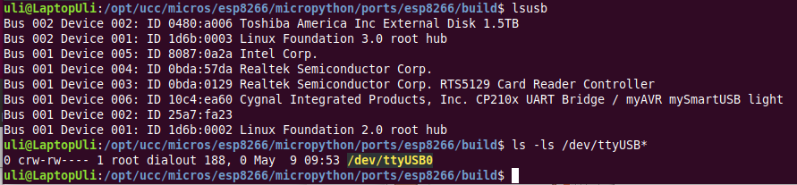
How to communicate with the Micropython interpreter?
We use a serial connection passing through the micro USB connection.
As soon as we connect the processor card to the PC we see the UART bridge and a new device: dev/ttyUSB0 is created.
This device is used to communicate with the Micropython REPL.

Slide 12
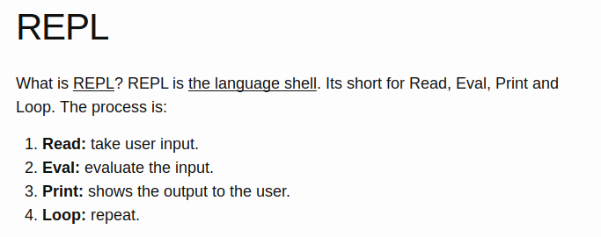
What is REPL?

Slide 13
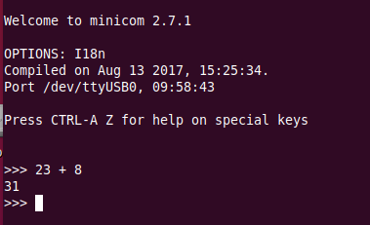
The communication tools minicom
The simplest tool is just a serial terminal emulator like minicom:
You see the command prompt and you can interact with Micropython. But … how to upload scripts?

Slide 14
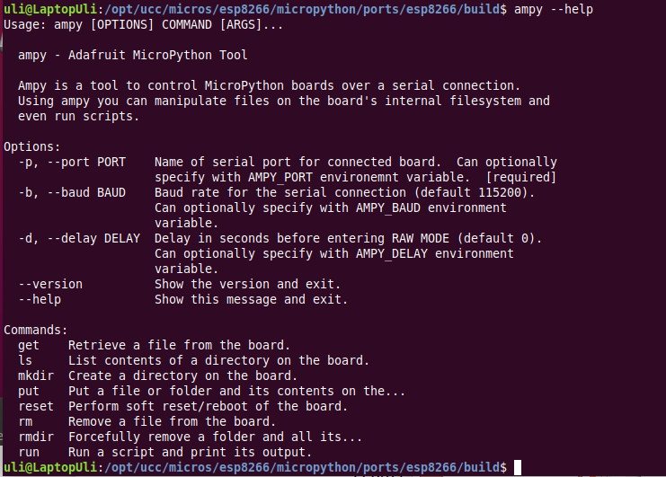
ampy

Slide 15
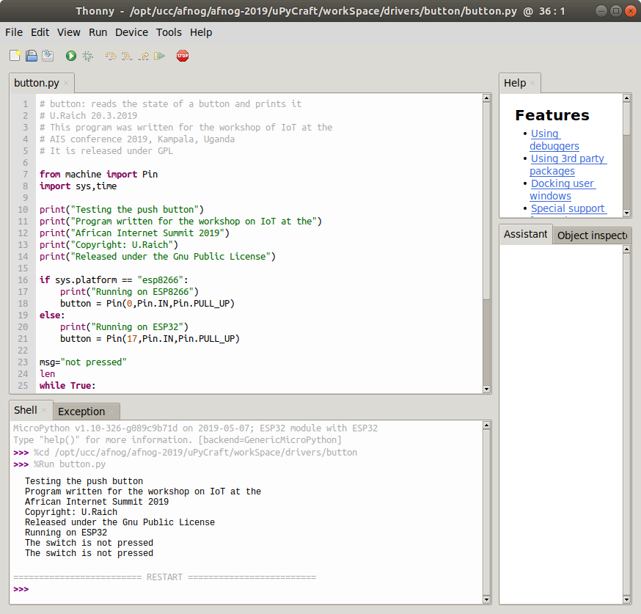
Thonny

Slide 16
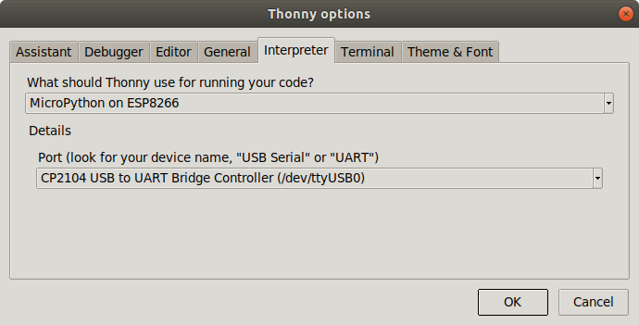
Thonny (2)
Thonny is an IDE for Python which has provisions for Micropython.
Under Tools → Options button you can select the type of Python interpreter you intend to use.

Slide 17
IoT Hello World program
A “Hello World” program, just printing “Hello World” on the screen does not look very exciting.
However, this is generally used to verify that the infrastructure
Compiler, linker, downloader, flash program
are working correctly
In embedded systems printing can be quite complex and a blinking LED is used instead.

Slide 18
Switching on and off a LED
The ESP8266 and the ESP32 have a “user LED” connected to GPIO 2.
How do we control this LED?
Define that the LED is connected to GPIO 2
Program this pin as output
Write a logic 1 to the pin to switch it on
Write a logic 0 to the pin to switch it off
The logic state may be inverted if the LED is active low

Slide 19
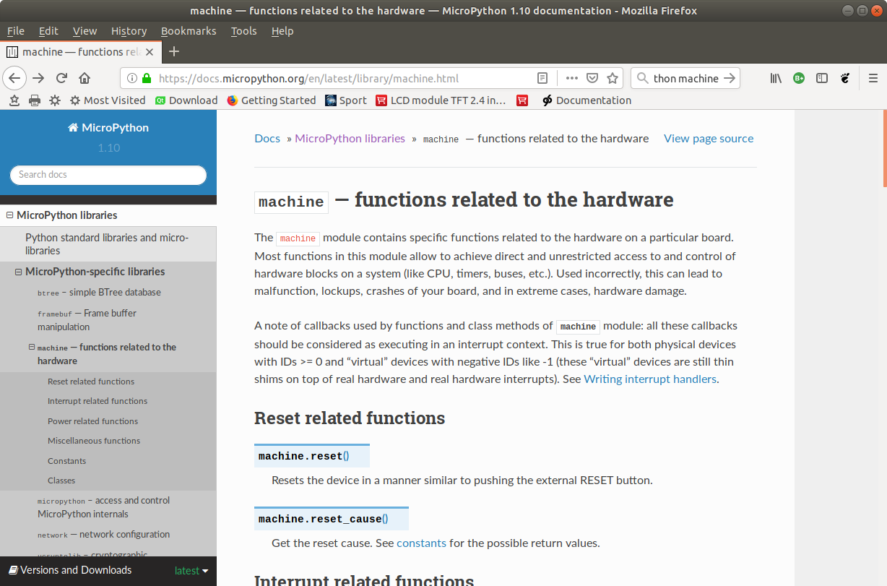
Micropython hardware functions

Slide 20
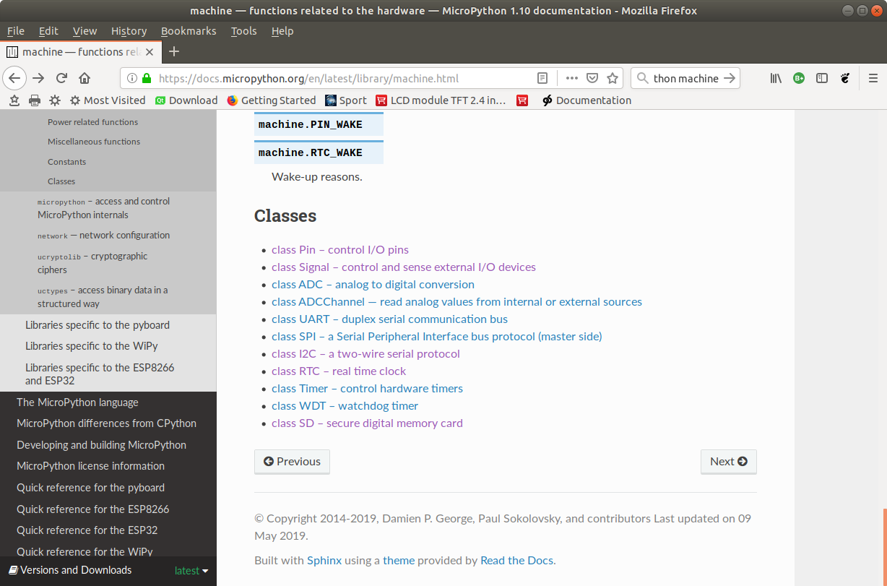
The machine.Pin class

Slide 21
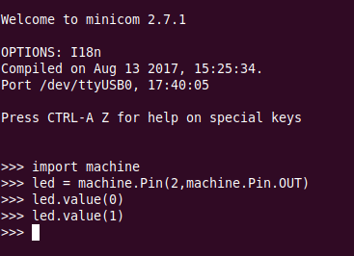
Switch the LED on, version 1
… and there was light!

Slide 22
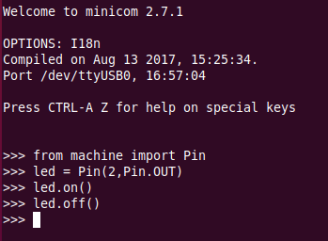
Switch the LED on version 2

Slide 23
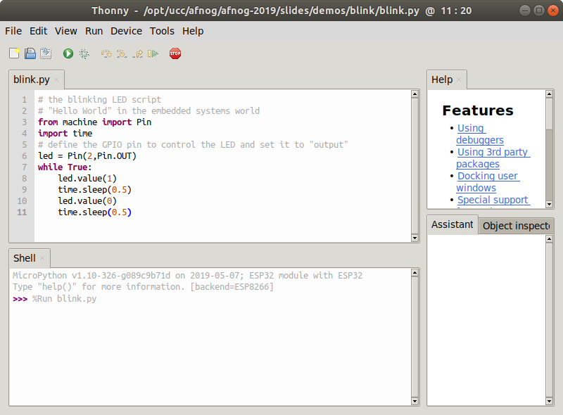
The blinking LED in Micropython

Slide 24
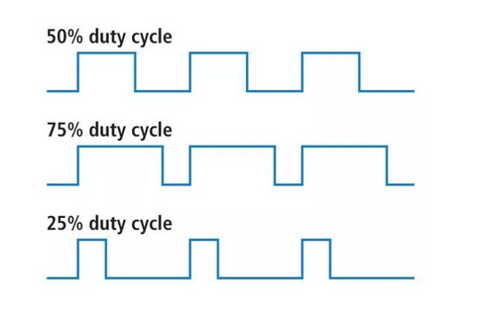
Changing the light intensity
The LED is connected to a digital line which can only be set to 0 or Vcc. How can we change the light intensity and dim the LED?
The light intensity depends on the average current flowing through the LED. The answer is PWM: pulse width modulation.

Slide 25
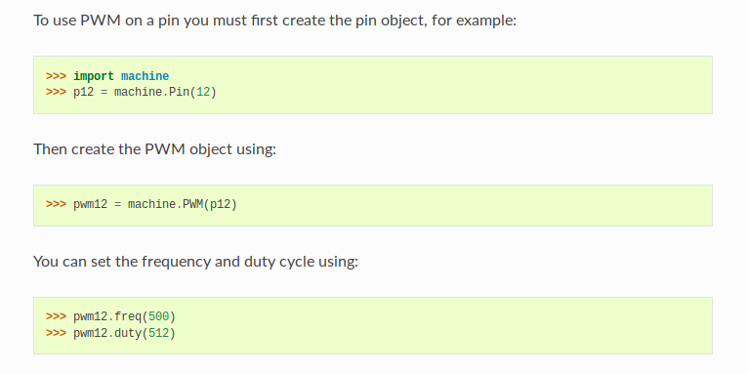
PWM in Micropython

Slide 26
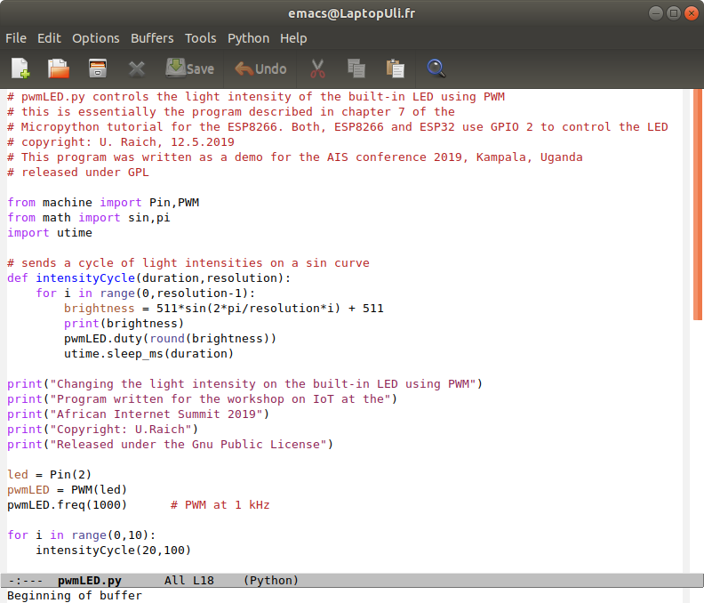
Our PWM implementation

Slide 27
The WS2812B LED
A more complex LED:
rgb LED used in LED chains.
each ws18b12 contains the 3 colored LEDs and a controller.
Can be cascaded and individually addressed, depending on its position in the chain
Needs precise timing
To use it we pass through the neopixel library built into MicroPython

Slide 28
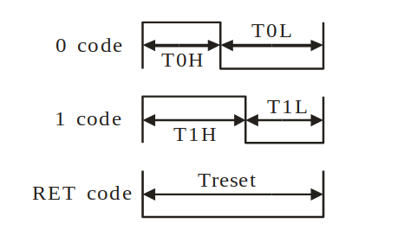
WS2812B timing
For all the details on the ws2812b look at
https://cdn-shop.adafruit.com/datasheets/WS2812B.pdf
24 bit of colour data puts
2²⁴ colours at your disposal

Slide 29
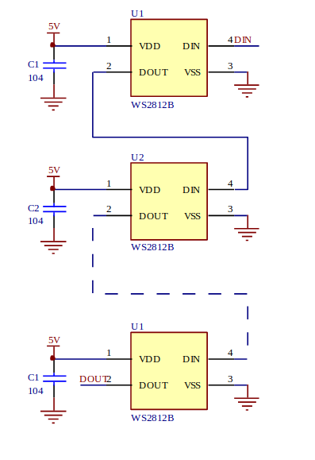
Cascading the WS2812B

Slide 30
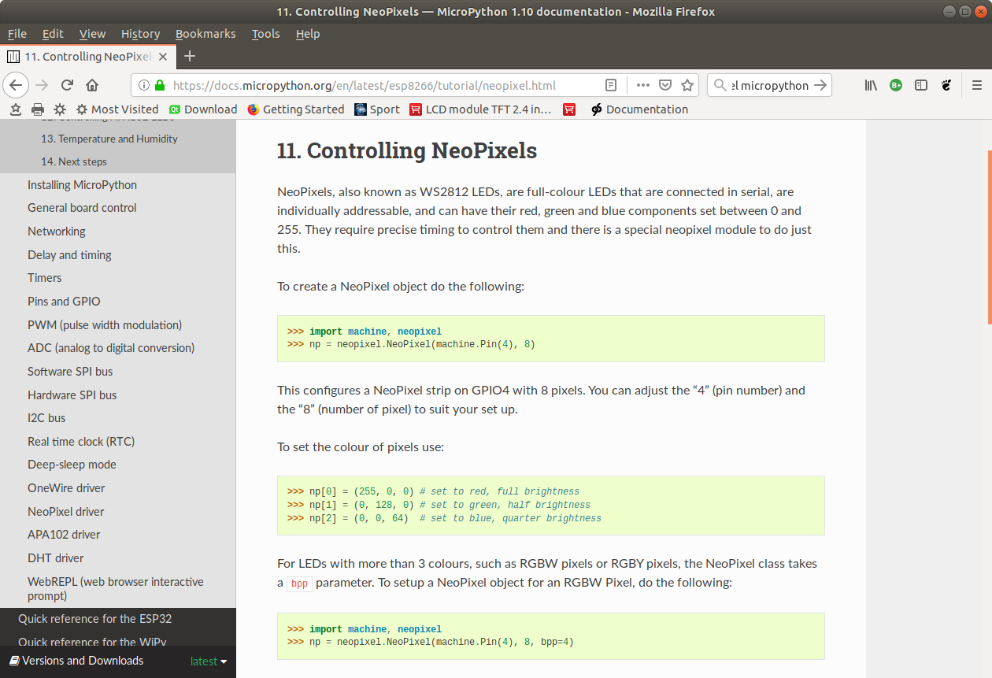
Using the neopixel library

Slide 31
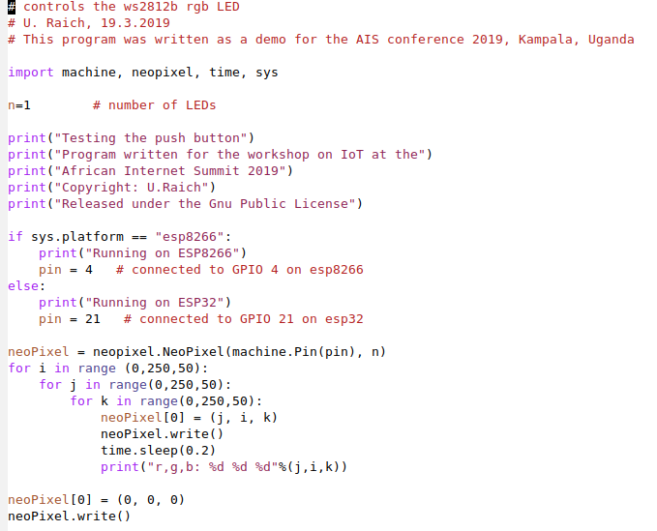
… and our code
We have a single neopixel connected to
GPIO pin 4 (ESP8266)
or
GPIO pin 21 (ESP32)
This code works on both CPUs!

Slide 32
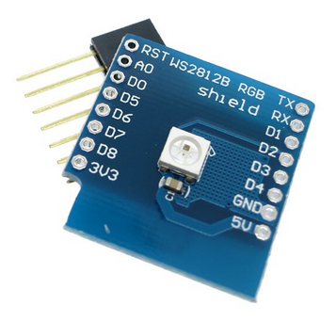
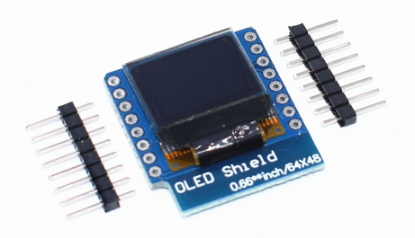
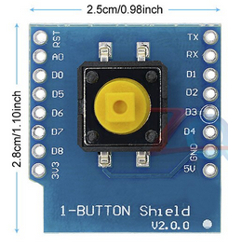
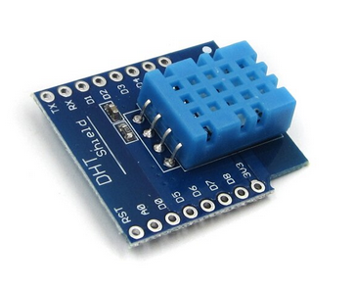
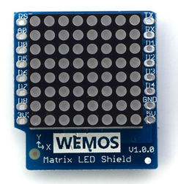
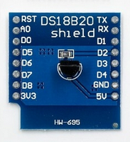
WeMos D1 mini sensor and actuator shields (1)
ssd1306 46x64 OLED display
push button
ws2812b rgb LED
dht11 temperature and
humidity sensor
8x8 LED matrix
ds18b20 digital thermometer

Slide 33
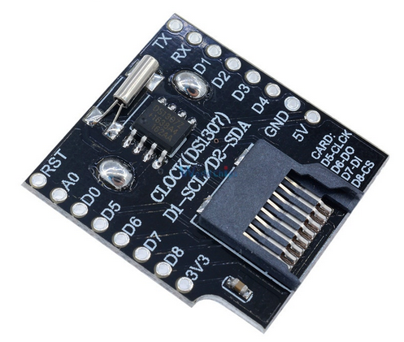
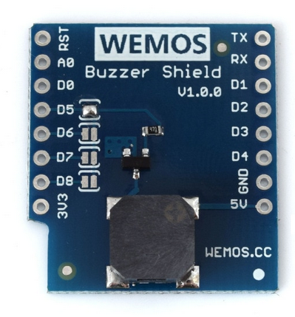
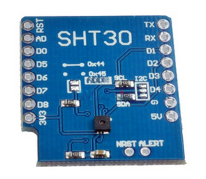
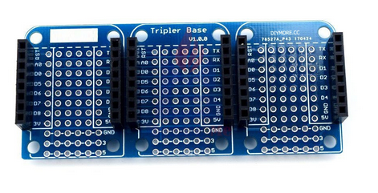
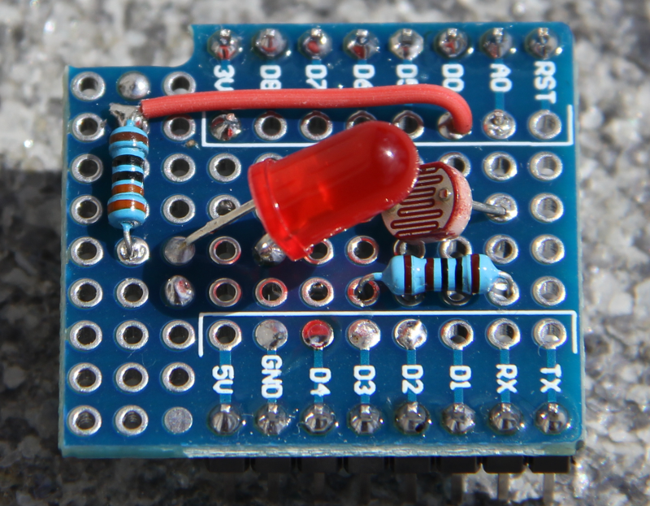
Wemos D1 mini sensor and actuator shields (2)
temperature and humidity
sensor
buzzer
data logger and RTC
Triple base
prototype board

Slide 34
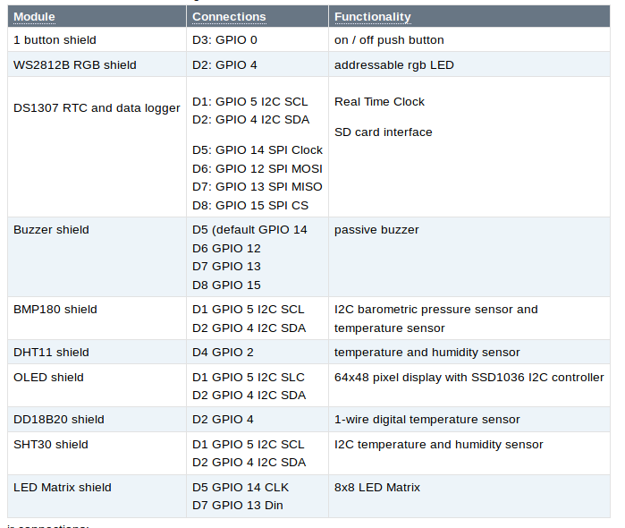
Pinouts of Shields

Slide 35
The data logger
The data logger features a DS1307 Real Time Clock (RTC) backed up by a battery
An SD card socket also provided.
This allows to store large amounts of data locally
The RTC keeps the time and measurements can be supplied with a time tag
Programs to set and read the RTC are provided.
One of the programs setting the RTC gets the time from and NTP server such that manual specification of the current date and time are not needed.
https://github.com/uraich/MicroPython_IoTDemos/tree/master/drivers/ds1307

Slide 36
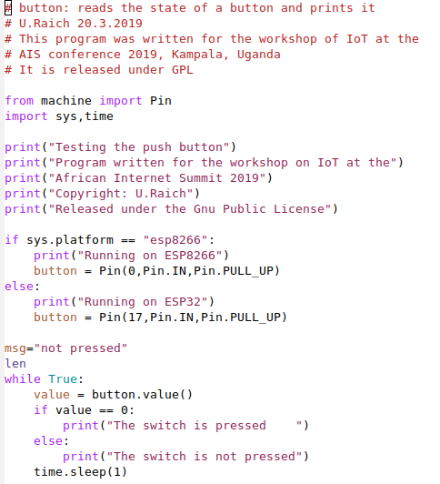
The pushbutton shield
A simple push button
connected to
GPIO 0 (ESP8266)
Or
GPIO17 (ESP32)

Slide 37
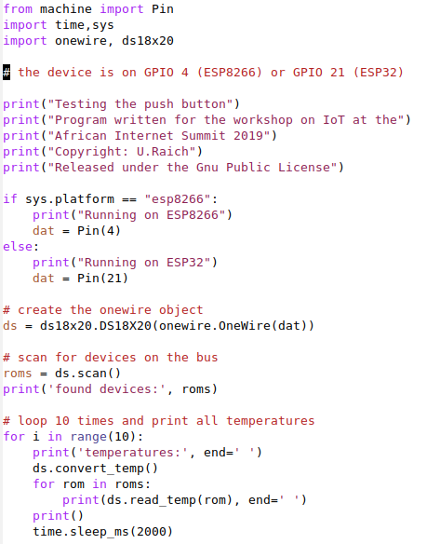
DS18B20 shield
A digital thermometer
using the Dallas
1-wire bus

Slide 38
SSD1306 48x64 OLED display
This one is also an I2C device
It provides 48*64 pixels and allows to
Write a few characters of text
Do simple graphics
The ssd1306 class inherits from the framebuf class included in Micropython such that all drawing methods of the framebuf are available for drawing:
https://docs.micropython.org/en/latest/library/framebuf.html
For an example see:https://github.com/uraich/MicroPython_IoTDemos/tree/master/drivers/oled

Slide 39
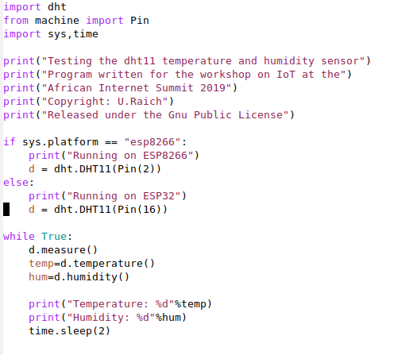
The DHT11 shield
The DHT11 is a digital temperature
and relative humidity sensor. It uses
a proprietary protocol of communication with its controlling host implemented in the
dht.DHT11 class

Slide 40
The LED matrix
The LED matrix has 8x8 LEDs on it, which can individually be switched on or off.
In addition to the mled class which takes care of the communication between the host and the device and which has classes to clear the display, set a pixel on or off and to change the brightness, I wrote a class matrix which takes a number 0..64 and lights this number of LEDs starting from bottom left

Slide 41
The buzzer
This shield implements a passive buzzer.
A passive buzzer takes a frequency (an active buzzer takes a signal level) and produces a sound at this frequency.
This means that the frequency can be changed and a tune can be played.
In
https://github.com/uraich/MicroPython_IoTDemos/tree/master/drivers/buzzer
you will find a program interpreting songs on RTTTL (Ring Tone Text Transfer Language) and playing these on the buzzer
A small song library is also provided

Slide 42
The prototype module
This is a home build module featuring a photo-resistor measuring the light intensity impinging on it.
It provides an analogue value converted to digital by the ADC on the WeMos D1 CPU
Please note that the ESP8266 has a single 10 bit ADC while the ESP32 has 3 12 bit ADCs. A MUX provides up to 18 analogue channels
The light intensity can be changed with an LED

Slide 43
The triple base
This module allows to easily stack a rather larger number of shields to a sandwich.
Make sure however that the GPIO lines used by the modules do not clash!

